Slide 1
D-310 Unit 4: Overhead

Slide 2
Objectives
Students will be able to:
Mobilize, reassign, and demobilize overhead resources in a safe and cost-effective manner.
Describe characteristics of specific overhead resources (e.g., single resources, teams, Technical Specialists [THSPs], modules).
Utilize supplemental forms associated with overhead mobilization, reassignment, and demobilization.
Describe the interaction the overhead dispatcher must have with the other functional areas within the incident support organization.

Slide 3

Incident Position Standards Alignment
This unit aligns with the following Expanded Dispatch Support Dispatcher (EDSD) Incident Position Standards located at
https://www.nwcg.gov/positions/expanded-dispatch-support-dispatcher/standards-and-references.
EDSD responsibility alignment
Review and manage existing requests.
Receive and manage new requests.
Communicate and manage resources in preparation for reassignment or demobilization.
Perform effectively in each of the four functional areas.
Establish and maintain communication with frequent contacts.

Slide 4
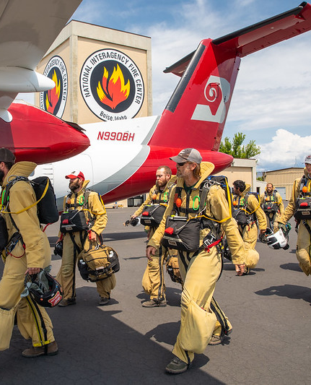
Overhead
Personnel ordered with “O” numbers as individual resources assigned to an incident
Notes:
Great Basin Smokejumpers Training | Bureau of Land Mangement… | Flickr

Slide 5
Overhead Positions
Identified by a four-character acronym
Examples
DIVS = Division/Group Supervisor
ICT3 = Incident Commander Type 3
FFT1 = Firefighter Type 1 (Squad Boss)
FAL2 = Intermediate Faller
Position code information
NWCG Standards for Wildland Fire Position Qualifications, PMS 310-1
Incident Qualifications and Certification System (IQCS) position codes

Slide 6
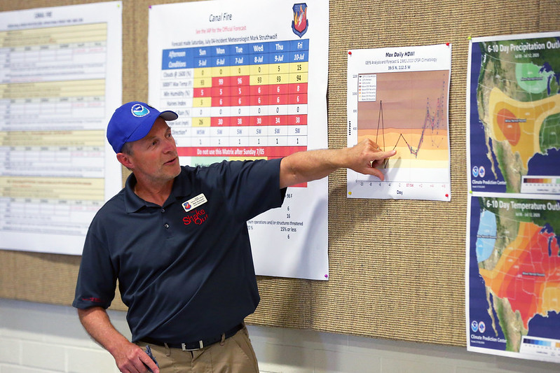
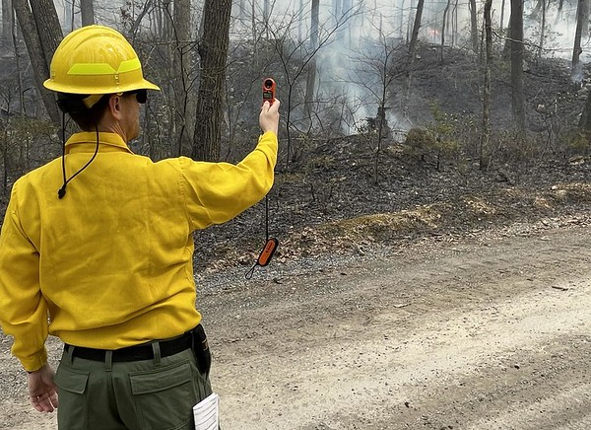
Technical Specialists (THSPs)
Duty Officer
Air Resource Advisor
Geographic Area Coordination Center (GACC) Meteorologist
Notes:
Canal Fire | National Weather Service Incident Meteorologist… | Flickr
Incident Meteorologist Taking Weather Observations | Flickr

Slide 7
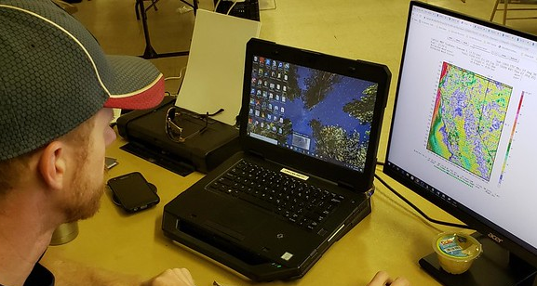
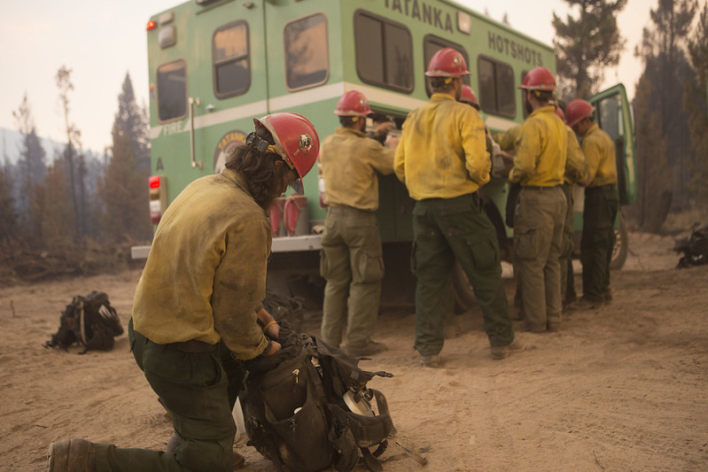
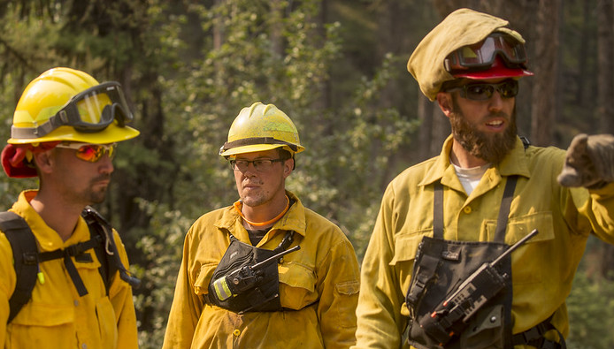
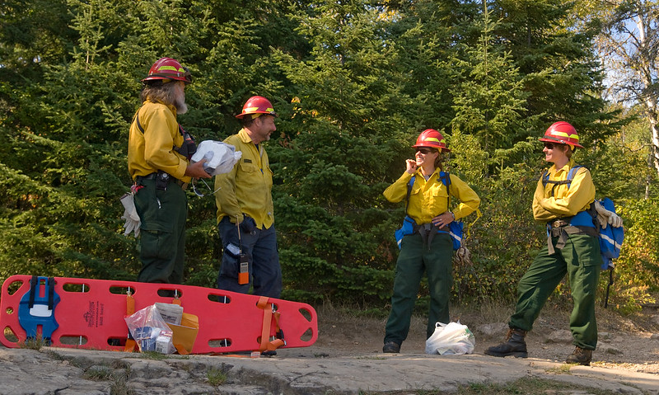
Administratively Determined Resources (ADs) & Emergency Firefighters (EFFs)
Notes:
Working the Rice Ridge Fireline, Tatanka IHC | Tatanka Hotsh… | Flickr
W5 Fire | An incident meteorologist provides a weather updat… | Flickr
Safety Officer Briefs Firefighters | A safety officer briefs… | Flickr
Firefighters Work the Rice Ridge Fireline | Firefightesrs li… | Flickr

Slide 8
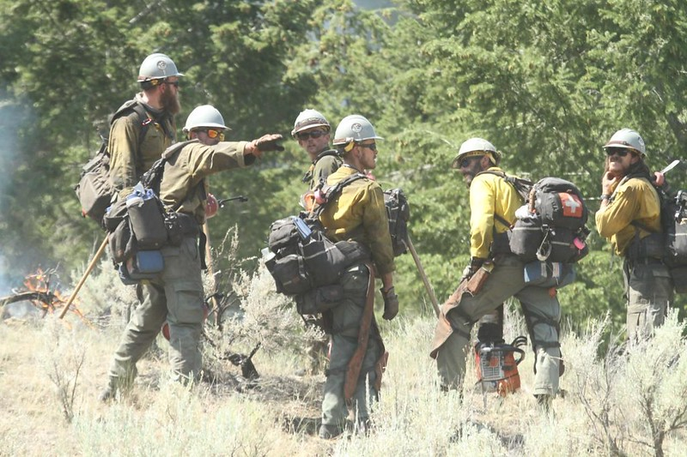
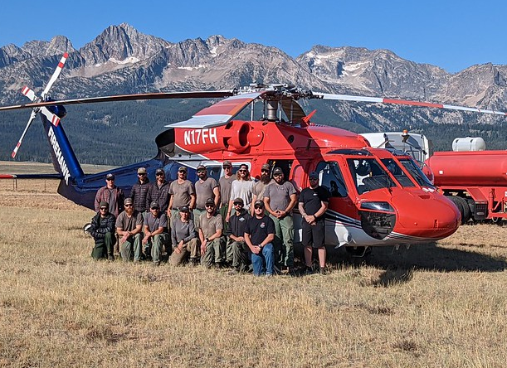
Modules
Modules are a trained group of individuals that provides a specialized task.
Examples:
Wildland fire module
Helicopter module
Other examples?
Notes:
Boise Helitack Crew Photo | Crew photo taken in Stanley, ID.… | Flickr
Moose Fire, Alta IHC | Alta Hotshots can be seen here perfor… | Flickr

Slide 9
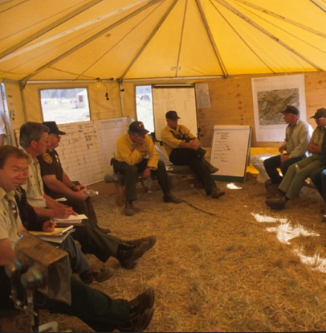
Teams (1 of 2)
Complex Incident Management Team (CIMT)
Buying Team (BUYT)
Geographic area and national
National Incident Management Organization (NIMO)
Critical Incident Stress Management (CISM)

Slide 10
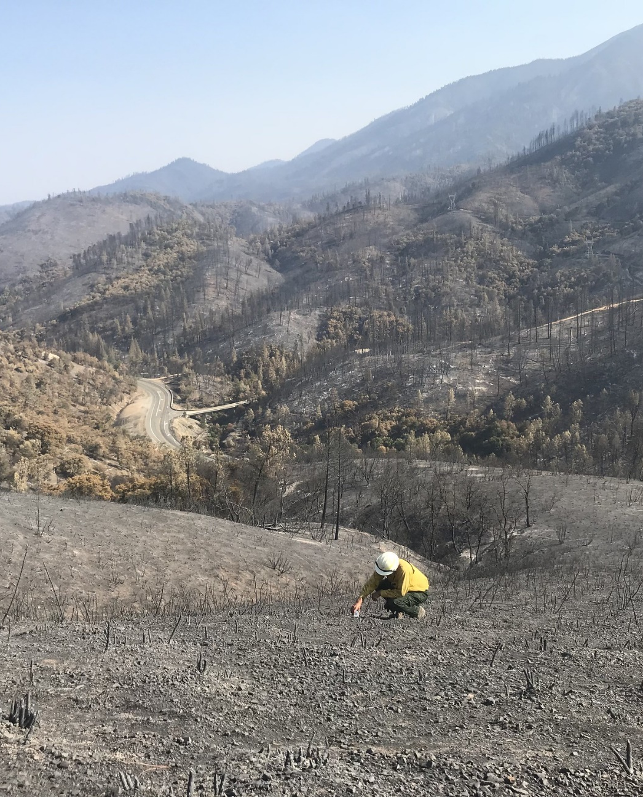
Teams (2 of 2)
Burned Area Emergency Response (BAER) Team
National Fire Prevention Education Team (NFPET)
Fire and Aviation Safety Team (FAST)
Notes:
Carr Fire Emergency Stabilization | Flood protection measure… | Flickr

Slide 11
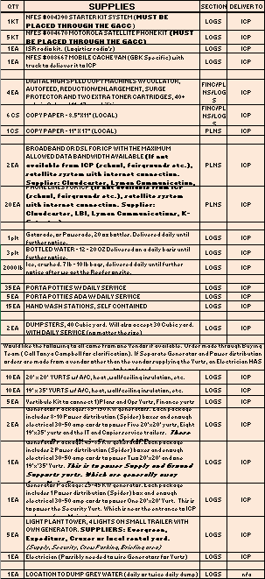
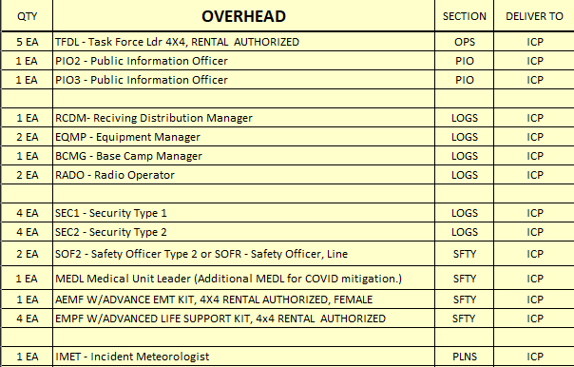
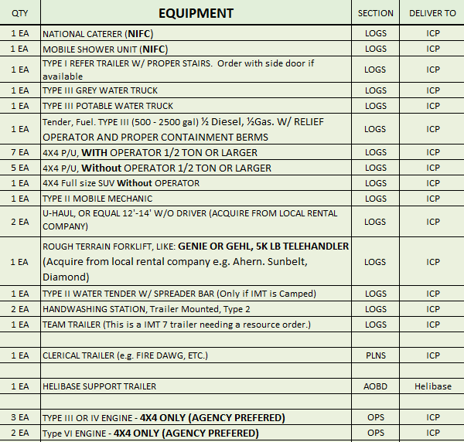
IMT Pre-Order
Upon initial mobilization, Incident Management Teams (IMTs) will have a pre-order.
The pre-order may request resources from ALL functional areas.

Slide 12

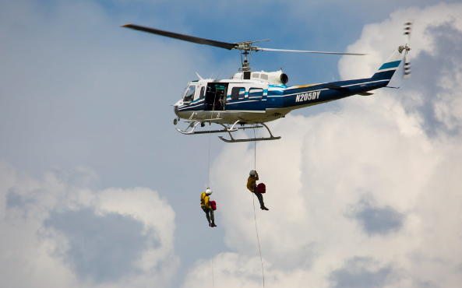
Smokejumpers and Rappelers
Usually ordered through Initial Attack (IA) dispatch.
Expanded dispatch may assist with booster orders.

Slide 13
Receipt of an Overhead Request
Is it an Incident Command System (ICS) position?
Are the correct position codes being used?
Is it a specialized position?
Can it be hired locally?
Are tools required with the overhead (e.g., programmable handheld radios, Global Positioning System [GPS], specific equipment)?
Are trainees, ADs/EFFs, portal-to-portal, or contractors acceptable?
Can the needed date and time be safely met?
When in doubt, ask questions.
Make sure you know what you are ordering!

Slide 14

Placing an Overhead Request
Clarify overhead ordering procedures at your initial briefing to ensure safety guidelines are met.

Slide 15
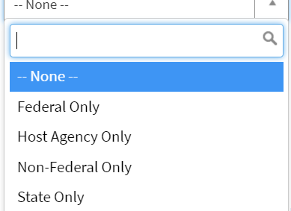
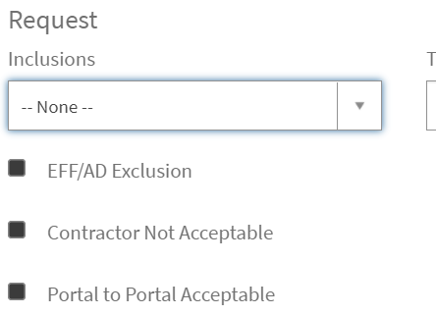
Finding Resources
Local resources
Special inclusions/exclusions
AD/EFF
Federal/Host Agency/State Only
Contractor
Trainee acceptable

Slide 16
Name Requests
The processing of name requests should always be discussed with the supervisory dispatcher prior to placement.
The individual named must be available and qualified for the assignment.
The ordering unit must have specific needs clearly stated when placing a name request.
When ordering a THSP, the position duties need to be clearly defined.

Slide 17
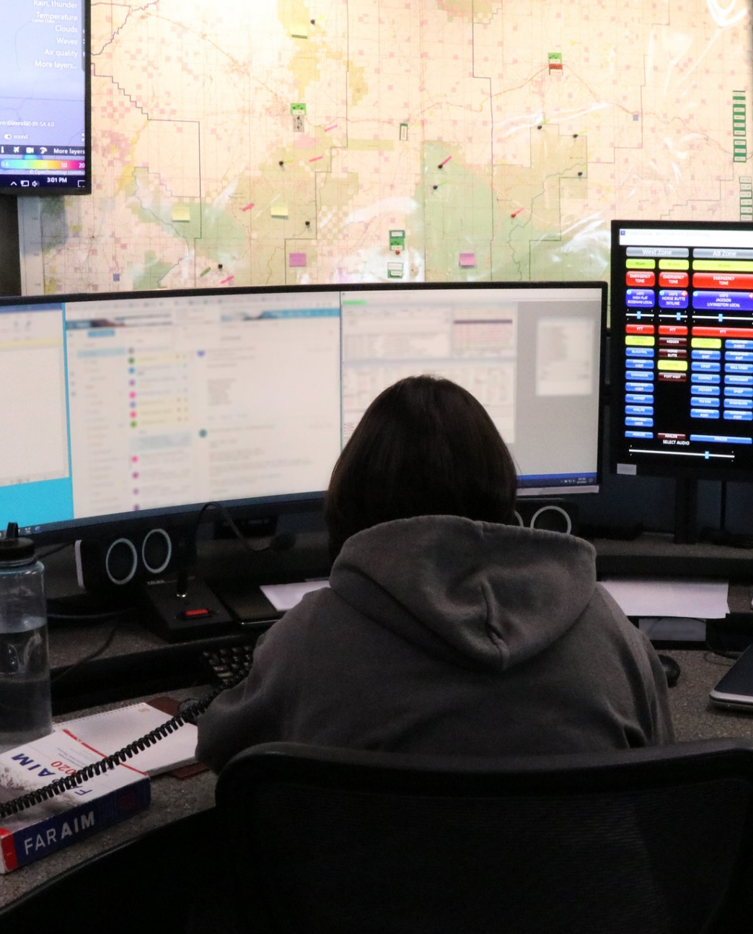
Reassignments
Follow local policy.
Work with the demobilizing incident.
Check for other qualifications.
Arrange travel.
Ensure the appropriate parties have received the completed order with travel.
Notes:
Interagency Fire Dispatch Center in Billings, Montana | Flickr

Slide 18
Unable to Fill (UTF) Policy
Refer to the National Interagency Standards for Resource Mobilization for the current policy.
If there is a known shortage of a requested resource, consider other alternatives.

Slide 19
Activity: Coordination with Other Functions (1 of 2)
Helicopter Manager (HMGB)
Contracting Officer’s Technical Representatives (COTRs)
Team
Airport Pickup
Strike Team Leader Crew (STCR)
Notes:
MAFFS Activation | Activating two MAFFS-equipped C-130 aircr… | Flickr

Slide 20
Activity: Coordination with Other Functions (2 of 2)
Helicopter Manager (HMGB)
Aircraft
Ground support
Crews
Equipment
Supervisor and all functions
Contracting Officer’s Technical Representatives (COTRs)
Team
Airport Pickup
Strike Team Leader Crew (STCR)

Slide 21
ICS Qualifications and Hierarchy
Become familiar with ICS qualifications and agency guides (e.g., NWCG Standards for Wildland Fire Position Qualifications, PMS 310-1).
The sending unit is responsible for certifying qualifications of overhead resources.

Slide 22

Additional Forms and Scenarios

Slide 23
Emergency Notifications and Releases
Notify supervisor
Document
Determine if replacement is needed
Consider method of notification
Maintain discretion and professionalism

Slide 24
Preparedness/Severity Orders
The Detail Request Form should be available on the GACC website.
Used to supplement staffing; not for emergency mobilizations.
Questions? Ask your Expanded Dispatch Supervisory Dispatcher (EDSP).

Slide 25
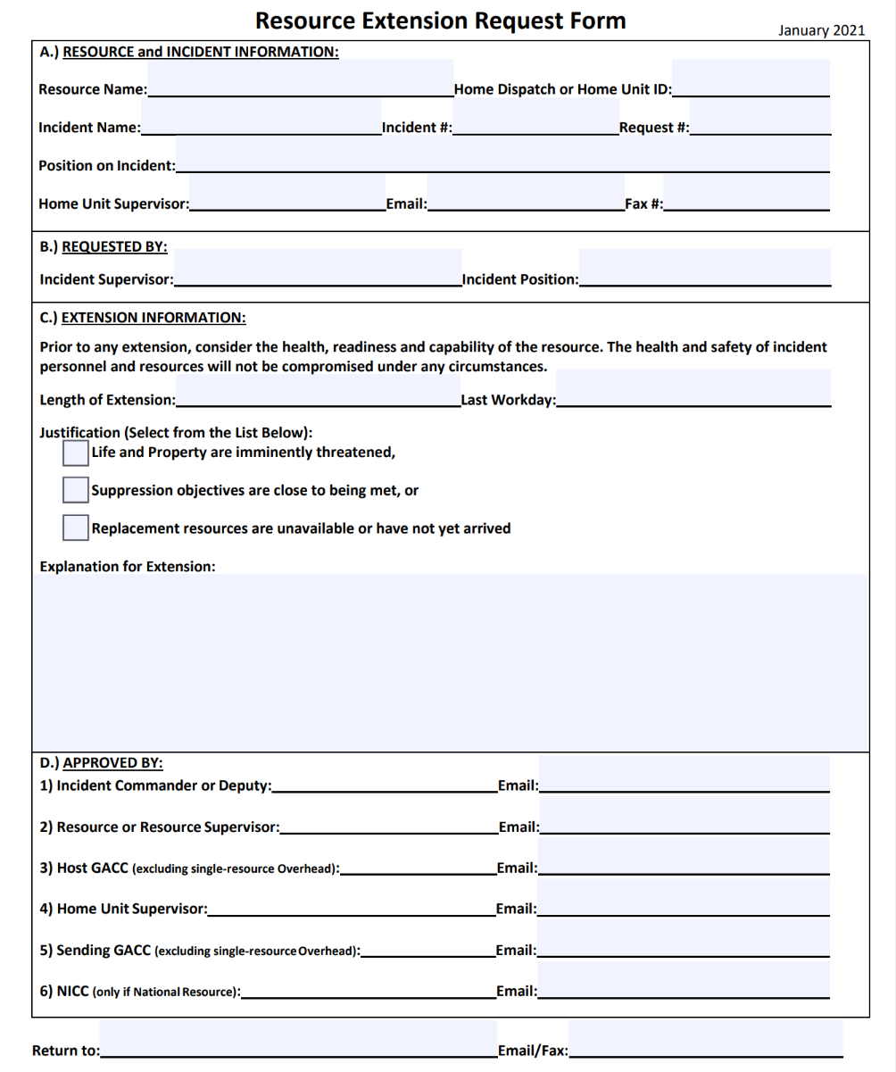
Other Supplemental Forms
Resource Extension Request Form
Demobilization/tentative release form
General Message (ICS 213)

Slide 26
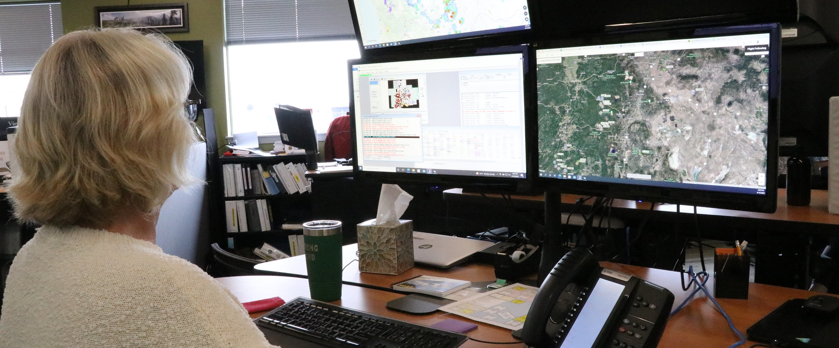
Activity: Filling Requests
What questions would you ask when processing these requests?
Notes:
Fire Dispatch in Redmond, Oregon | Redmond, Oregon A dispatc… | Flickr

Slide 27
Summary
Use of the THSP position code is only appropriate when no other appropriate position code exists.
Follow local procedures for AD/EFF hiring.
When you receive an overhead request, ask questions to ensure you know what you are ordering and understand local ordering procedures.
The procedures for processing name requests should always be discussed with the supervisory dispatcher and be clearly established at the initial briefing.
Follow local policy on reassignments. Many overhead resources may be reassigned.
The sending unit is responsible for certifying qualifications of overhead resources.
A Resource Extension Request Form is used to request permission signatures to allow resource extensions.

